Slide 1
INDIVIDUAL PRESENTATION
What I Did, and What It Taught Me
Gold and Oil Market Intelligence Project
A short walk through how I approached the project, the problem I nearly missed, and the habit I am taking away from it.

Slide 2
THE BRIEF
What I was asked to do
I was asked to act as part of a data engineering and analytics team for a financial intelligence company, and to move past describing what gold and oil prices did toward explaining why they moved.
Describe
what happened to prices
The work the brief really pointed at was not writing more queries. It was understanding the business question well enough to ask a better one, and being honest about what the data could support.
Explain
why they moved
Recommend
what to do next

Slide 3
MY APPROACH
How I worked through it
1
Fixed the pipeline
I traced the data pipeline and found the view the whole analytics layer relied on was never built. I rebuilt it and fixed three smaller breaks.
2
Loaded the real data
Six datasets: gold, oil, inflation, the dollar index, VIX, and world oil production.
3
Checked coverage first
Before joining anything, I asked whether the datasets even covered the same period.
4
Tested and reported honestly
I ran the hypotheses, then ran the whole pipeline to confirm its own outputs rather than trust the logic on paper.

Slide 4
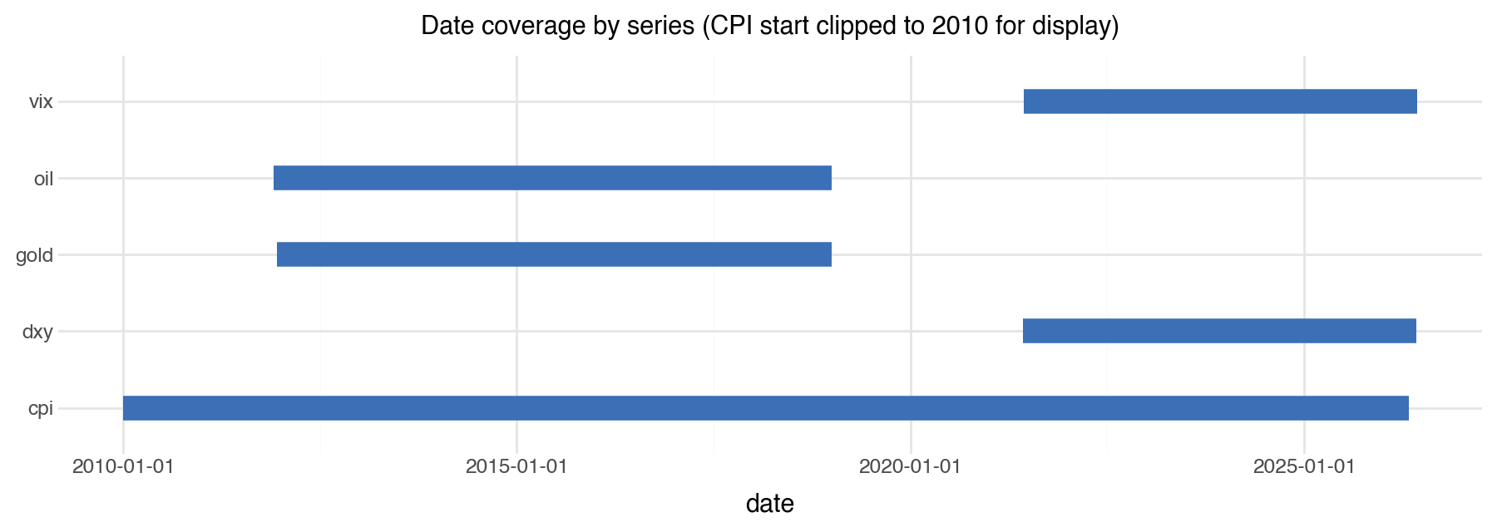
THE TURNING POINT
The problem I nearly missed
The price data ends in 2018. The dollar and volatility data starts in 2021.
They share no months at all. I only caught it because I plotted the coverage of each series and looked at it before trusting any join.
0 overlapping months
Four of the six questions could not be answered with this data at all.

Slide 5
RESULTS
What I could honestly show
-23% / -51%
2x
gold and oil over 2011 to 2018
oil was twice as volatile as gold
a commodity bear market, not a safe-haven run
month to month, by coefficient of variation
0.64 vs 0.01
p = 0.55
gold-oil link on levels vs returns
gold as an inflation hedge
the relationship is regime dependent, not fixed
not significant here; treat it as conditional

Slide 6
HOW I WORKED
Using AI as an assistant, not a replacement
The brief was direct: AI can help with code, but it cannot replace the thinking, and I should always ask whether the answer is correct and whether I have validated it.
The tools were fast at
drafting a pipeline, a notebook, and charts
But the judgments were mine
noticing the missing view, checking coverage before any join, refusing to let an empty result pass as a finding
So I validated everything
I ran the pipeline and read its real output tables instead of trusting the code on paper

Slide 7
REFLECTION
What I learned, and what I would change
What I learned
What I would change
Preparing and validating data is most of the work, and the value sits there.
A single correlation number can hide the truth; a rolling view tells it.
Saying clearly what the data cannot support is itself a finding.
Run the coverage check first, before any analysis at all.
Confirm that reused public datasets cover the same era at download time.
Treat the inflation hedge as conditional from the start, not as a given.

Slide 8
WHAT I AM TAKING AWAY
The most useful thing I produced was not a chart. It was the decision to be honest about the limits.
The engineering was sound and the figures were real, but the project only became trustworthy once I said clearly what the data could and could not support. That habit is what I am taking from this work.
Thank you.

